Slide 1

Optimising Accessibility
Creating accessible emails in Outlook

Slide 2

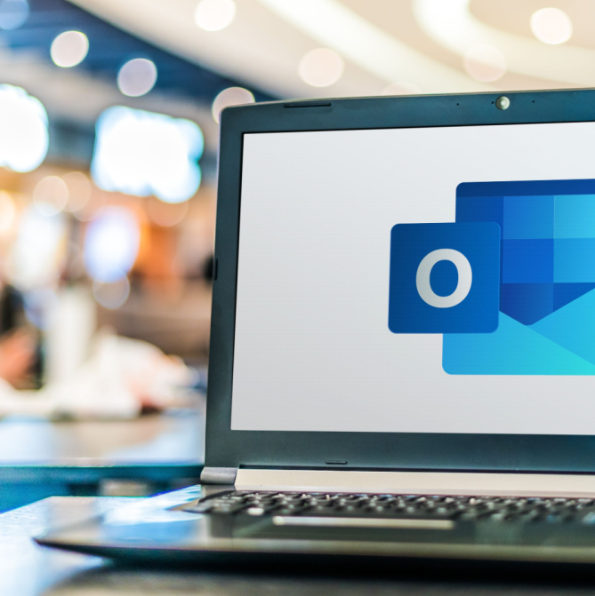


Accessibility in Email
People read emails in different ways and use different devices to do so. Some people use;
A screen reader, while others use magnification
High-contrast settings
Tools to help with complex words or phrases

Slide 3
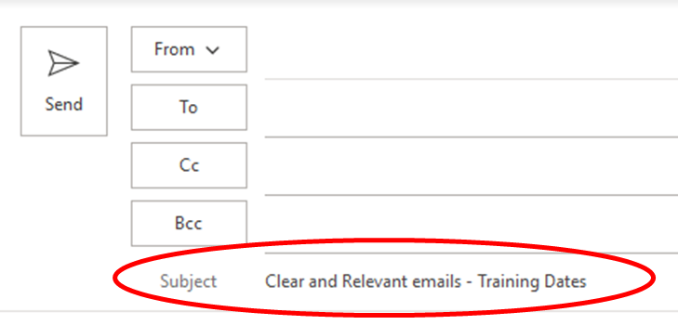
Subject line
Ensure the subject line is clear and relevant to your content. This helps;
  Everyone understand what the email is about
  You and the receiver search the inbox to retrieve the information later
If your email is important and/or urgent make this clear

Slide 4
Use heading styles
Use heading styles as you would for word documents for long emails.
For long emails, use a heading hierarchy e.g., Heading 2 and Heading 3. Having a consistent heading structure is always helpful. This can be helpful for items such as newsletter emails where you might also have a table of contents
They’re important because they help;
Screen reader users navigate to different information within the body of the email. Some screen reader users exclusively use headings and links to jump to the part of the email that’s relevant to them.
Break up the content visually

Slide 5
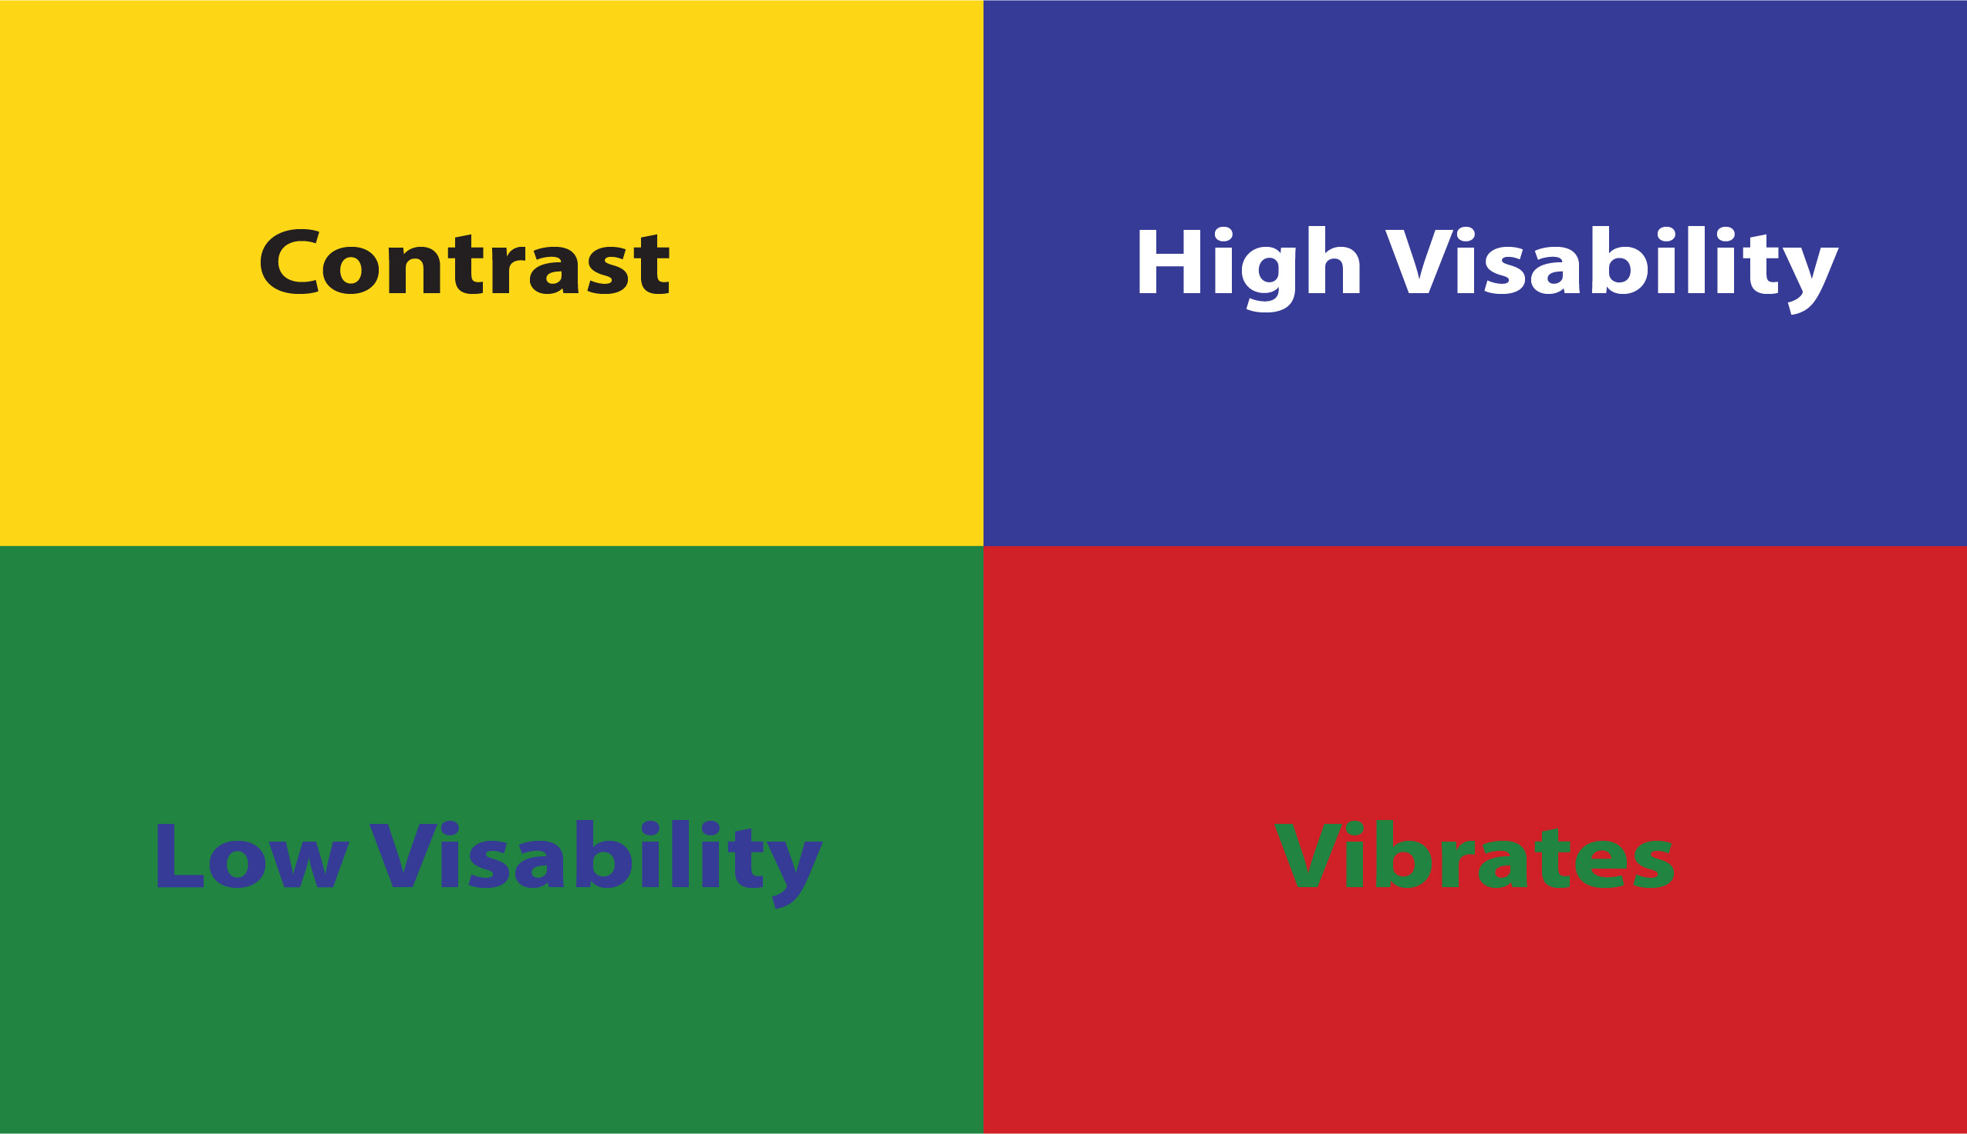
Use accessible colours
Avoid using colour to convey meaning, for example, using red text to indicate urgency.
Choose colours that give a good contrast if you need to use colour.
In Outlook, use the ‘Automatic’ setting for your email text. This means the text will display well even in high-contrast mode.
  Select your text.
  Select Message> Font Colour.
  Select Automatic.
Notes:
Things to say:
Using colour to convey information can exclude some people. Such as those a visual impairment or colour blindness
Always ask yourself:
‘Do the colours I’m using have enough contrast?’

Slide 6

Check for readability
Using plain language makes it easier for the reader to get the information fast. Avoid:
Long sentences
Complicated language
Acronyms
Abbreviations
Corporate jargon

Slide 7
Use fonts that are easy to read
Accessibility 8
Accessibility 12
Accessibility 14
Accessibility 18
Accessibility 24
Accessibility 36
Accessibility 48
Some fonts are easier to read than others. Colt has chosen Ariel as it is readable and universal.
Ensure you use Arial, the Colt brand font for documents
Make sure your text is at least size 12pt in size
Avoid italics, as it’s harder to read for people with dyslexia and other conditions
If you use bold to emphasise something, a screen reader will not pick this up. Use another indicator, such as a sub-heading that says ‘important’
Notes:
Things to say:
The easier a font is to read, the more accessible it is.

Slide 8
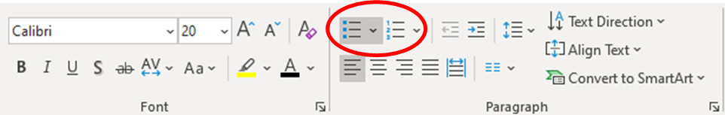
Use lists
Using lists makes your message easier to read.
Bulleted or numbered lists effectively present information and break up your message into small, manageable chunks.
Lists are useful when you want to give someone a list of actions or tasks to complete or share a lot of information
Formatted lists mean that screen reader users can distinguish this information from the rest of the body text.
They are helpful for people that use assistive technology.

Slide 9
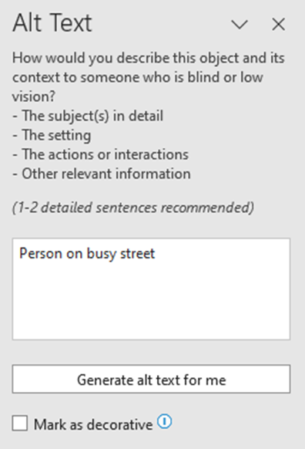
Add alt-text to images
Newsletters and marketing emails often contain images. But these images are not always accessible.
To make them accessible, add alt-text, unless they are decorative.
Alt-text provides a written description of the image which is read out by screen readers.
It also benefits sighted users when images do not load due to a poor or slow internet connection.
This includes any images in your email signatures.
Never use the “Generate alt text for me”, as this is usually wrong.
Notes:
PowerPoint has a checker to help you with this. It is a quick and simple way of making sure that there are no major accessibility challenges in your deck. Using it is simple and can be found on the review tab

Slide 10
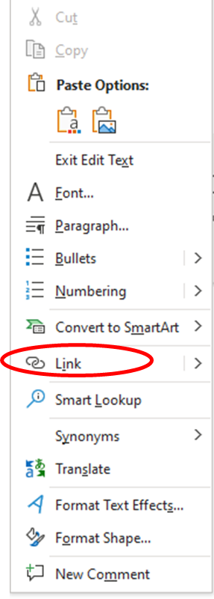
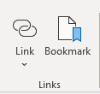
Make link text meaningful
We often share links in emails, especially marketing emails, including newsletters.
When linking to resources or web pages, link text should be clear, with a clear indication of where it leads to.
For example, ‘sign up for our latest news’ explains where the reader is directed to when they follow the link.
Detailed links make things much easier for everyone.

Slide 11
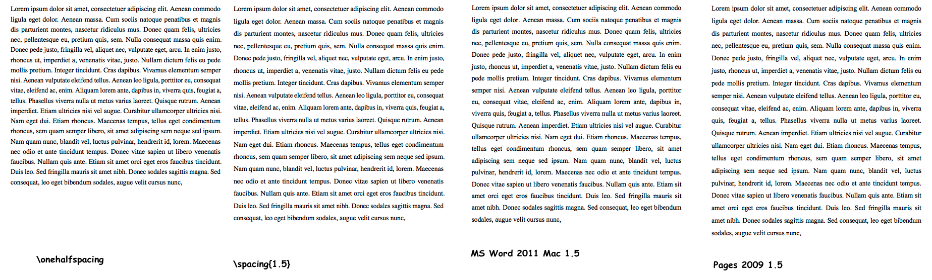
Formatting your emails
Ensure enough space between lines and paragraphs to make the words easier to read.
If you need to use tables in your emails, mark up the table headers so that screen reader users can understand the data.

Slide 12
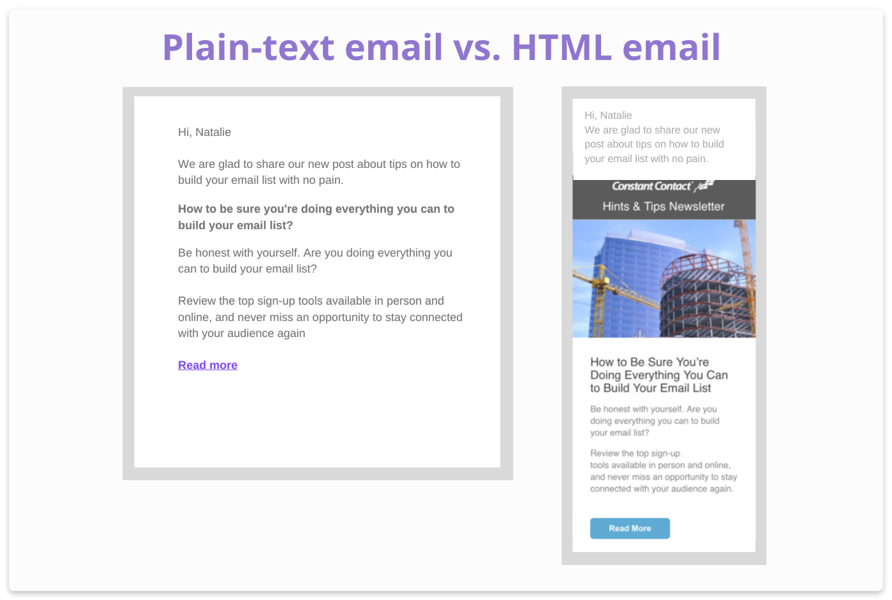
Include a plain-text version
If you are sending marketing emails, you can include a plain-text version.
Plain-text emails are simpler with no images, embedded links or design features.
Some people who use assistive technology may prefer to use the plain-text version with the email's main content.
It’s often best to offer people a choice of which version they would like to receive.

Slide 13
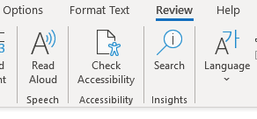
Use in-built accessibility checker
Check the accessibility of your email using the checker included in Outlook..
Whenever sending an email, whether for work or personal reasons, think about accessibility.
Outlook has an option for you to let others know that you would prefer content in an accessible format. This can encourage others to think about accessibility

Slide 14

Further sources of information
More information on making email accessible can be found at:
Make your Outlook email accessible (Microsoft Support)
Creating accessible emails (AbilityNet)
Accessibility in email marketing (Mailchimp)
BBC guide to accessible newsletters

